Slide 1
Global E-Commerce Sales Analysis
Data Analyst Portfolio Project
Delia Dwi Anjani
Linkedin : Delia Dwi Anjani
Github : https://github.com/Delia-Dwi-Anjani/Project_Global-E-Commerce-Sales
Python
Data cleaning, feature engineering & exploratory data analysis
Power BI
Interactive attrition dashboard & business insights
Excel
Pivot analysis, slicers & interactive dashboard
Portfolio Presentation • Data Analyst

Slide 2
Project Overview
Structure of the analysis from business problem to recommendation
01 Business Context
Background, problem, objectives
02 Dataset & Preparation
Data understanding, cleaning, feature engineering
03 EDA in Python
Patterns and factors associated with attrition
04 Power BI Dashboard
Interactive visual analysis and KPIs
05 Excel Dashboard
Pivot-based dashboard with slicers
06 Insights & Recommendations
Key findings, business implications, next steps
2

Slide 3
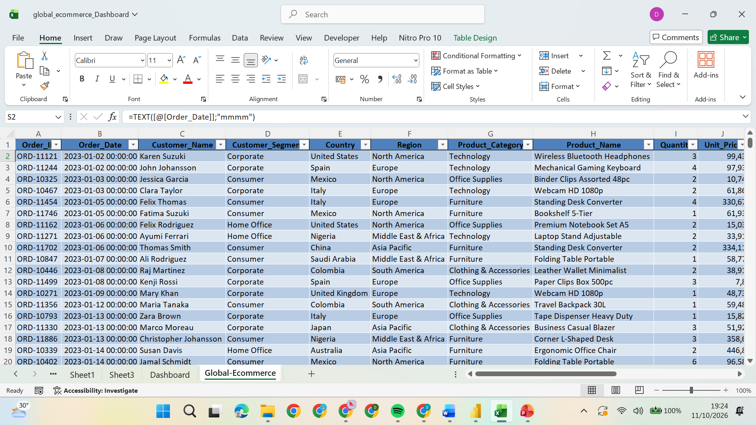
1. Business Background
Why employee attrition matters
The global e-commerce industry operates in a highly competitive environment where businesses must continuously monitor sales performance, customer purchasing behavior, and profitability to maintain sustainable growth.
Although high sales revenue indicates strong market demand, it does not always translate into higher profitability. Factors such as product performance, discount strategies, shipping costs, and regional differences can significantly affect business outcomes.
Therefore, a data-driven approach is essential to identify sales patterns, evaluate product and customer performance, and uncover opportunities for improving operational efficiency and profitability.
This project analyzes global e-commerce transaction data to transform raw business information into actionable insights that support strategic decision-making.
3

Slide 4
2. Business Problem & Objectives
Business Problem
Sales Performance: Limited visibility into sales trends and fluctuations across different periods.
Product Profitability: Uncertainty about which products and categories generate the highest revenue and profit.
Customer Performance: Insufficient understanding of customer segments and their contribution to overall sales.
Regional Performance: Differences in sales and profitability across countries and regions require further evaluation.
Discount & Shipping Costs: The relationship between discount levels, shipping costs, and profitability needs to be assessed.
Analysis Objectives
Evaluate Sales Performance: Identify sales trends, revenue patterns, and key business performance indicators.
Assess Product Profitability: Determine top-performing products and categories based on sales, profit, and profit margin.
Analyze Customer Behavior: Evaluate customer segments, purchasing patterns, and average order value.
Identify Market Opportunities: Compare regional and country-level performance to identify potential growth opportunities.
Support Profitability Optimization: Examine discount and shipping cost patterns to develop data-driven business recommendations.
4

Slide 5
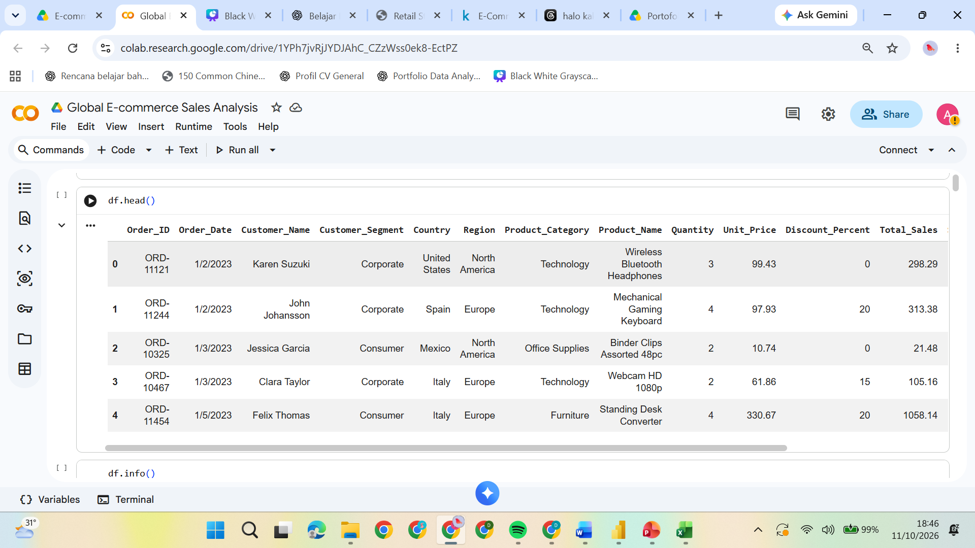
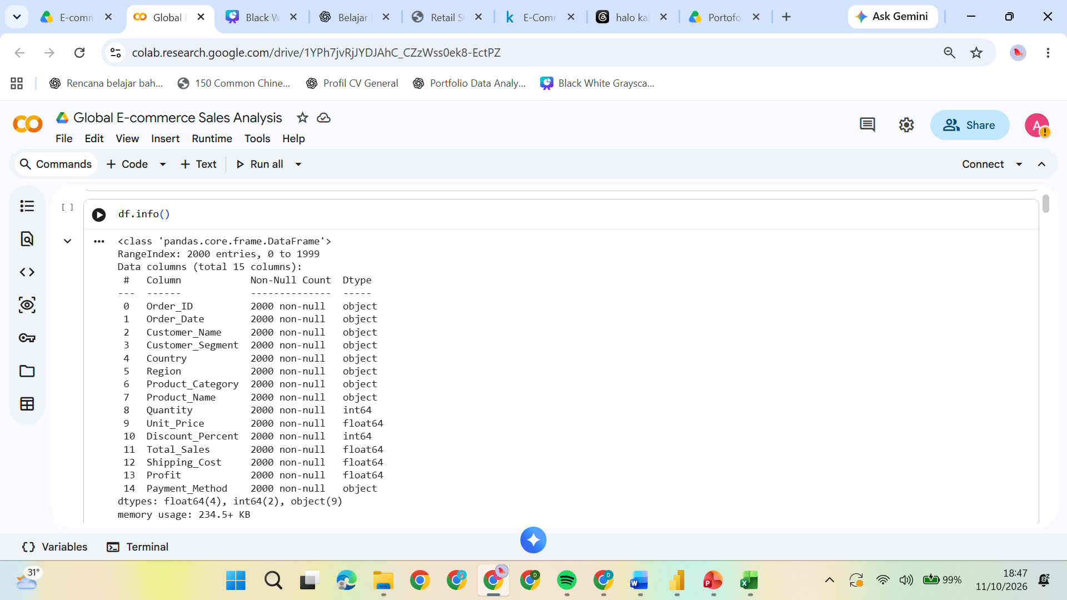
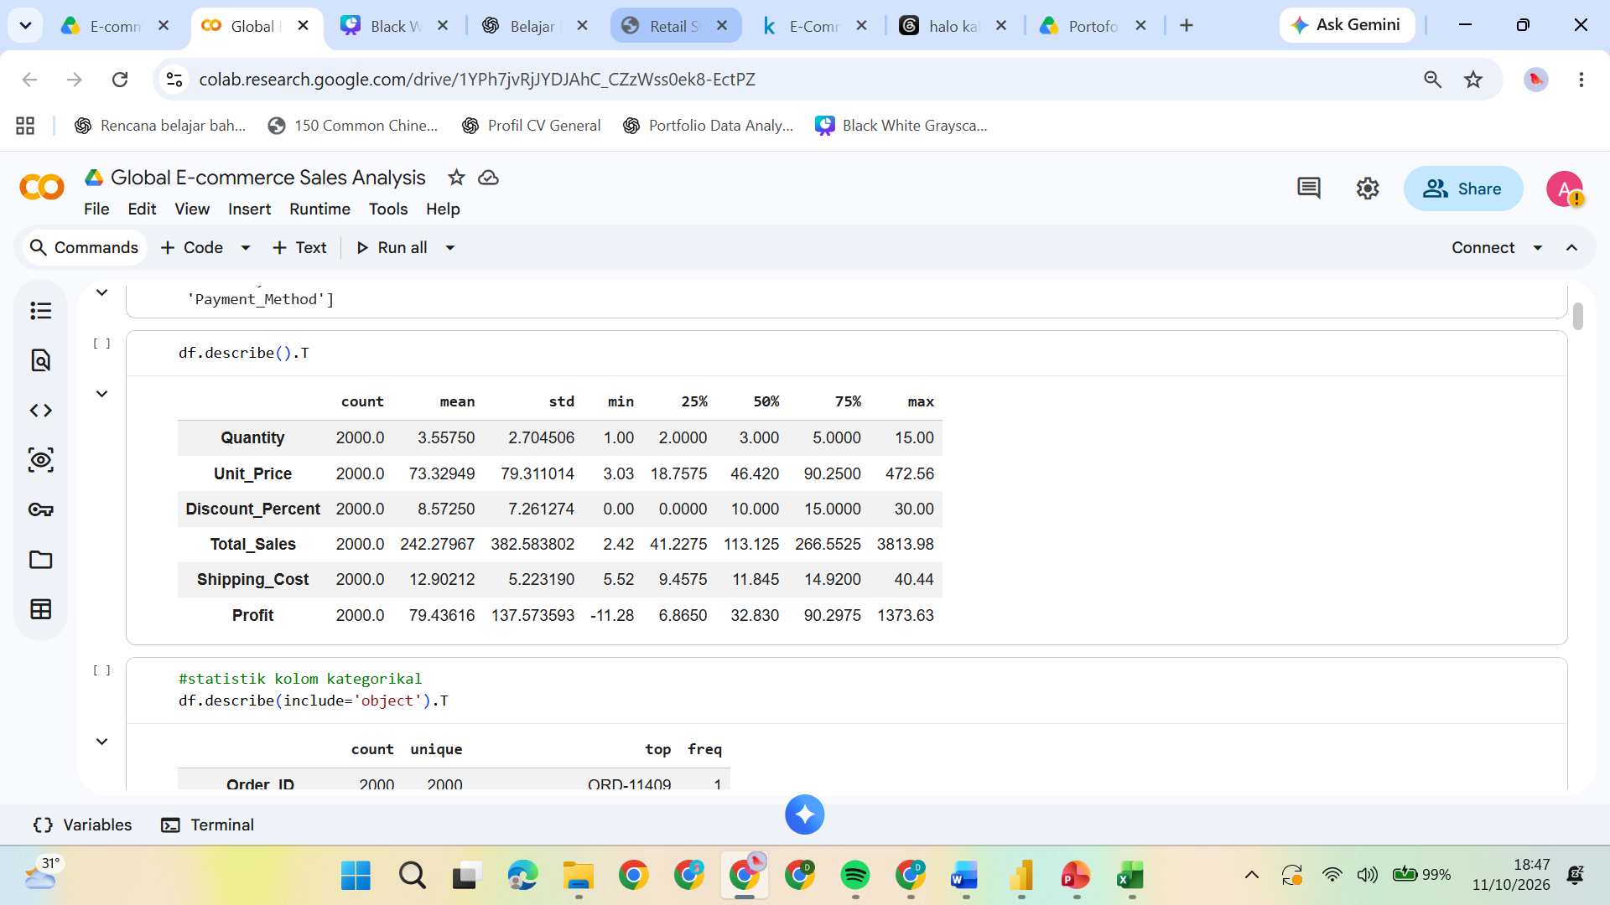
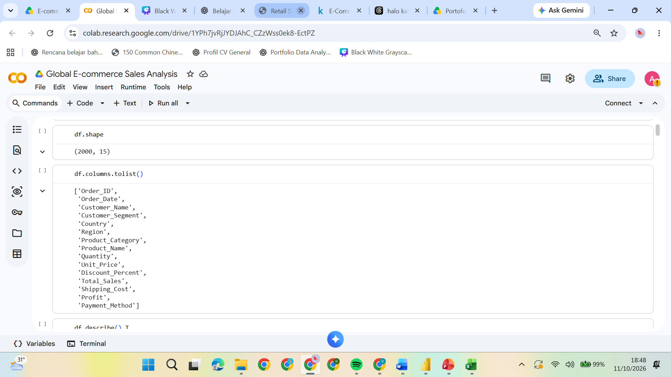
3. Dataset Overview
HR employee-level dataset used for attrition analysis
5

Slide 6
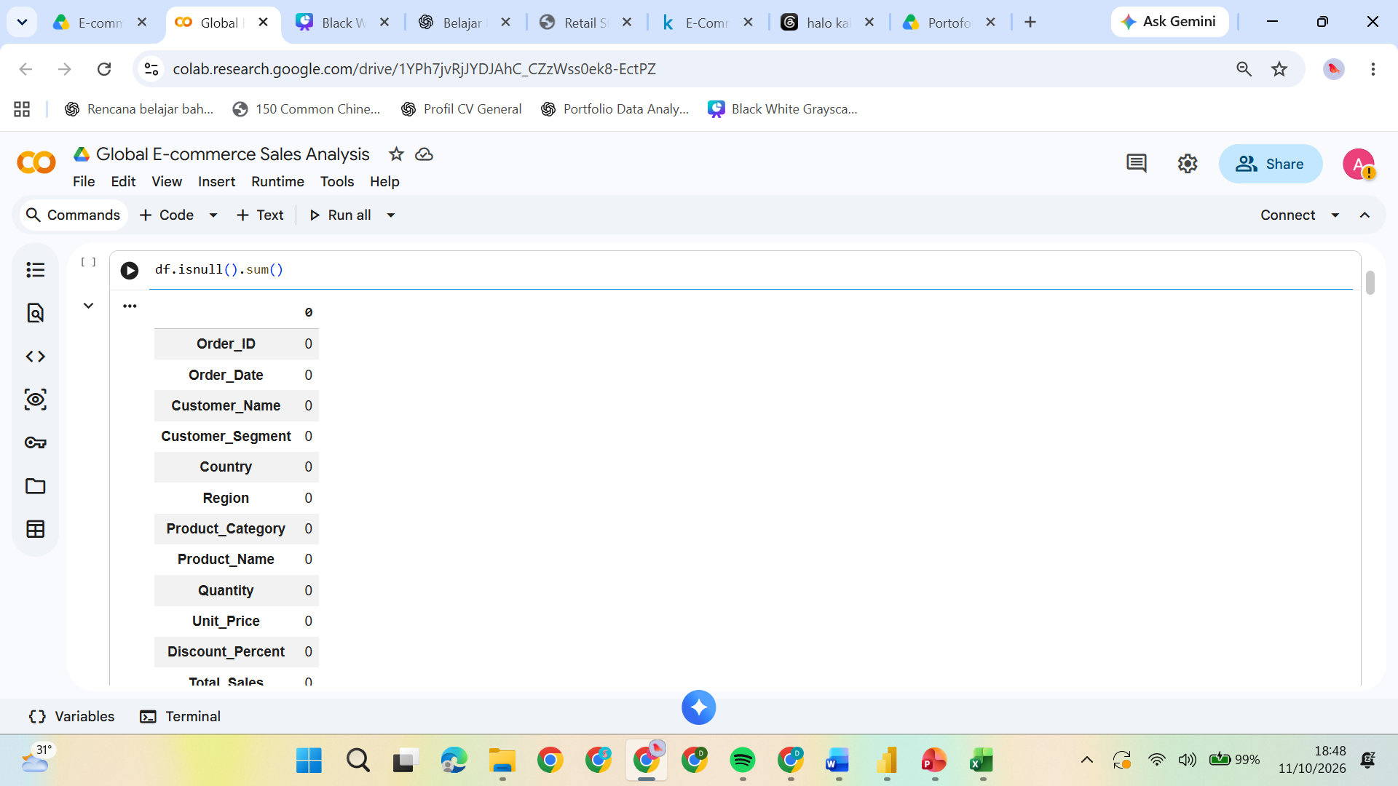
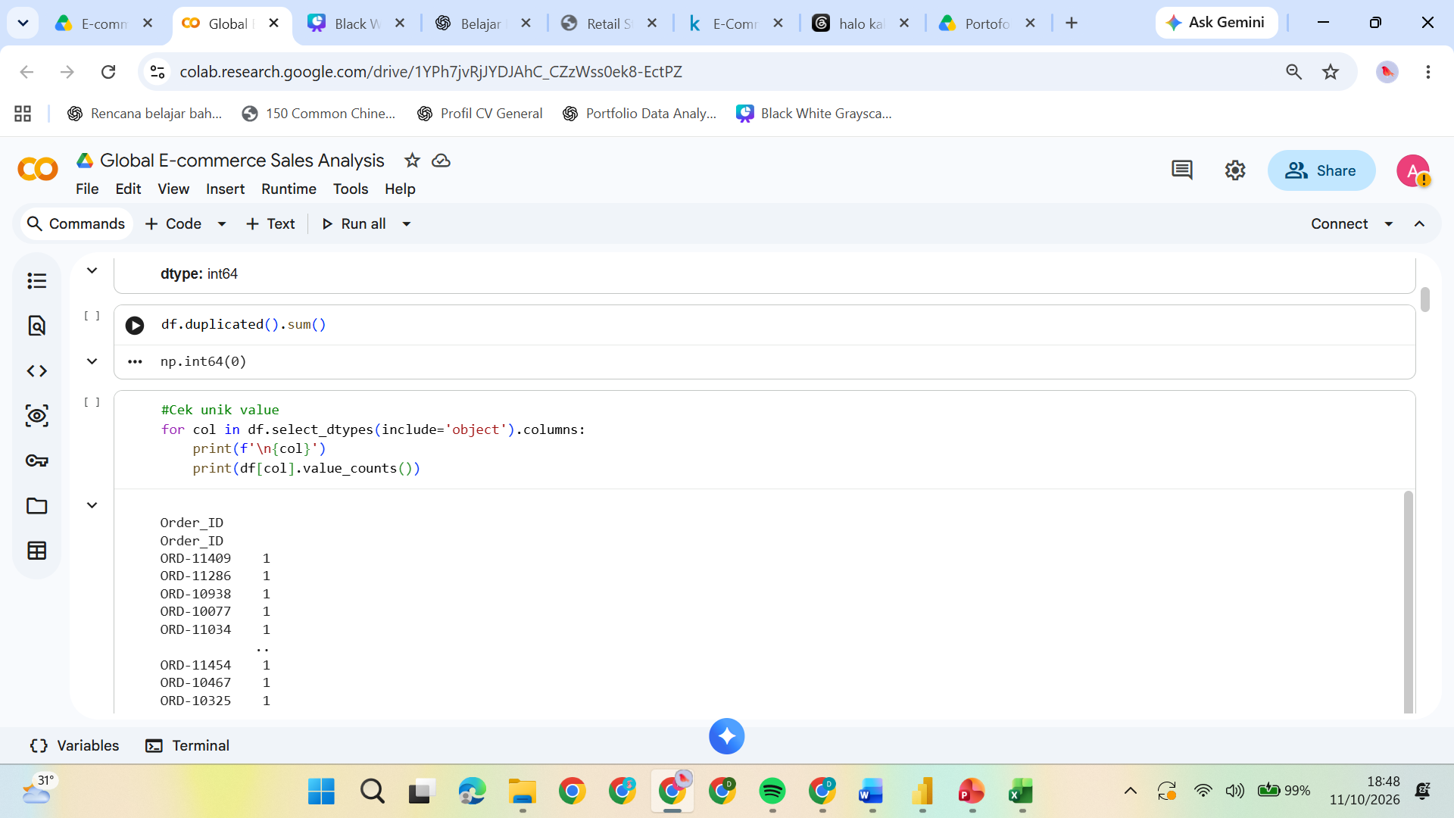
4. Data Cleaning & Preparation
Python workflow before visualization
Data Quality Assesment
Inspected dataset structure, data types, and missing values.
Identified duplicate records and potential data inconsistencies.
2. Data Clenaning
Standardized data formats and corrected data types.
Reviewed missing values and validated numerical data.
3. Data Transformation
Prepared date-related features for time-series analysis.
Prepared sales, profit, and other key business metrics.
4. Final Data Validation
Rechecked data consistency and completeness.
Exported the cleaned dataset for further analysis in Excel and Power BI.
Outcome: An analysis-ready dataset for reliable business reporting and visualization.
6

Slide 7
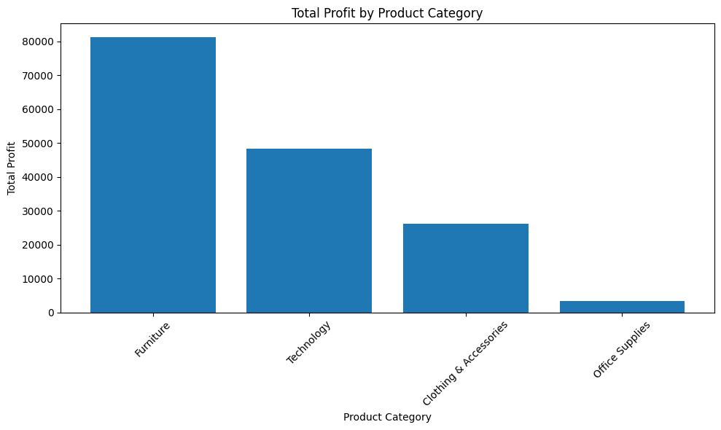
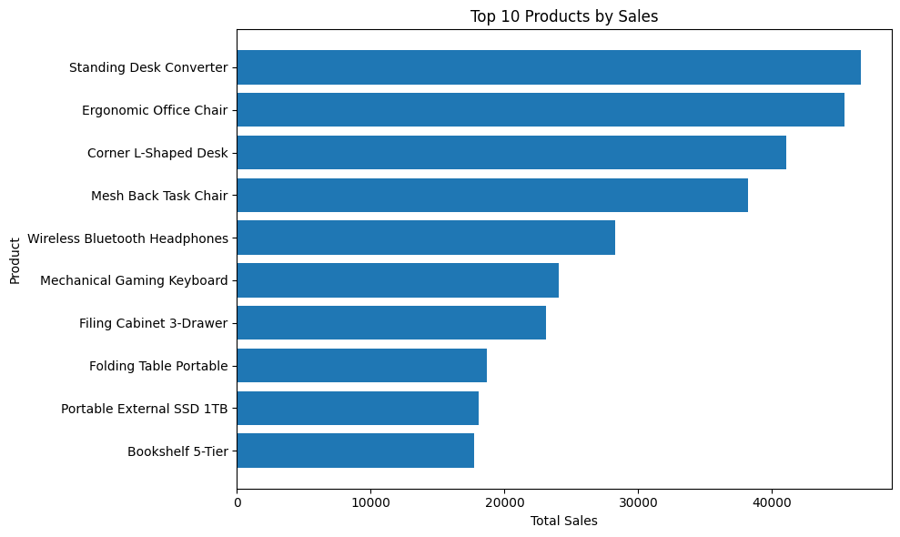
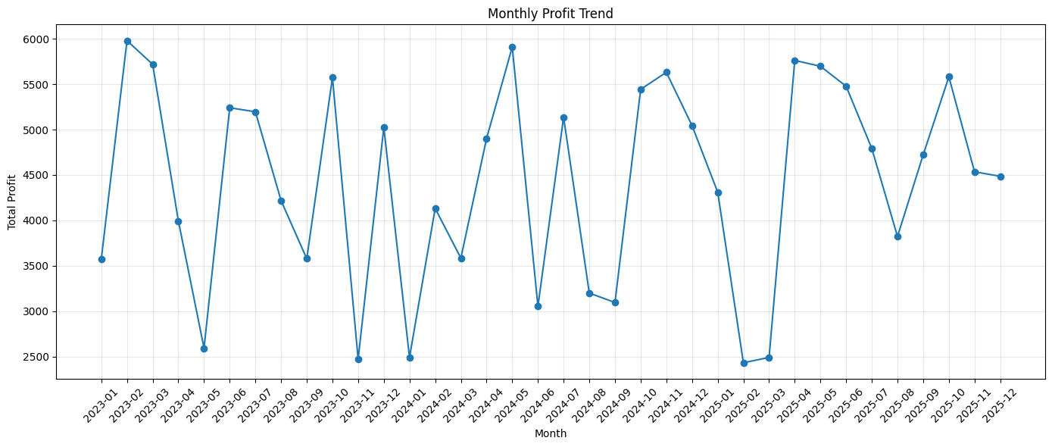
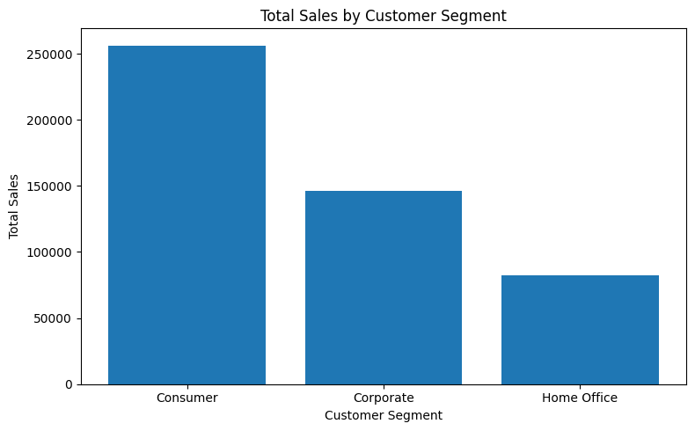
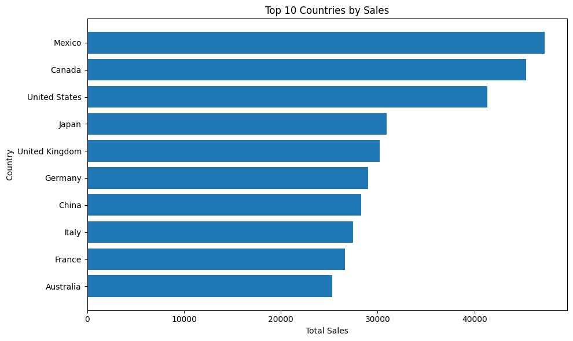
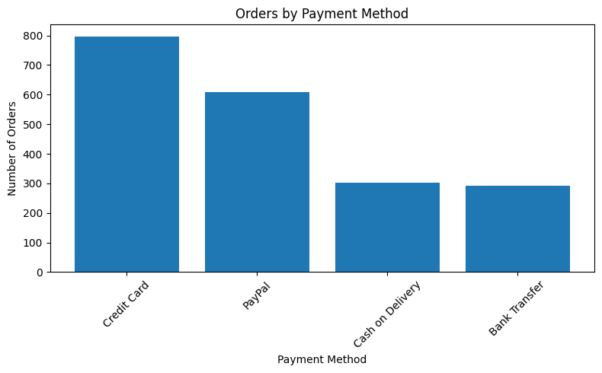
5. Exploratory Data Analysis (Python)
Core visual questions explored
INSERT PYTHON VISUAL
Attrition Distribution
INSERT PYTHON VISUAL
Attrition Rate by Department
INSERT PYTHON VISUAL
Attrition Rate by Job Role
INSERT PYTHON VISUAL
Attrition Rate by OverTime
INSERT PYTHON VISUAL
Attrition Rate by Age Group
INSERT PYTHON VISUAL
Tenure / Income Analysis
7

Slide 8
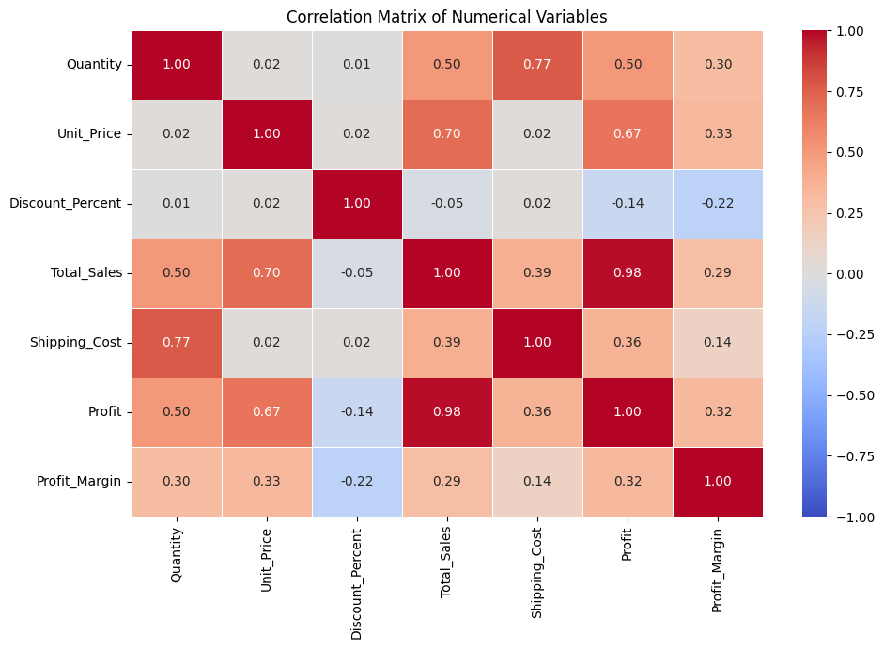
6. Correlation & Supporting Analysis
Supporting numerical relationships
INSERT SCREENSHOT
Correlation Matrix / Attrition Correlation
How to Interpret
Positive Correlation (+): Both variables tend to increase together.
Negative Correlation (−): As one variable increases, the other tends to decrease.
Weak Correlation (Near 0): Little or no linear relationship between the variables.
Strong Correlation (Near +1 or −1): A strong positive or negative linear relationship.
8

Slide 9
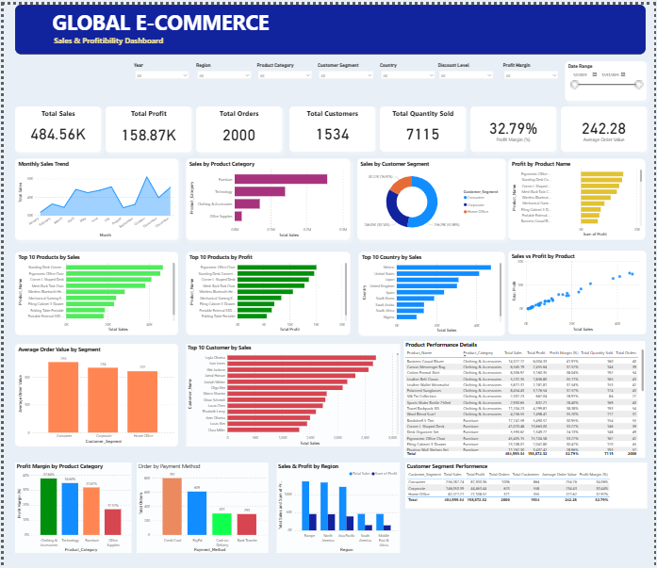
7. Power BI Dashboard
Interactive workforce attrition overview
INSERT SCREENSHOT
FINAL POWER BI DASHBOARD
KPI Cards
Interactive Filters
Main Analysis
Purpose
9

Slide 10
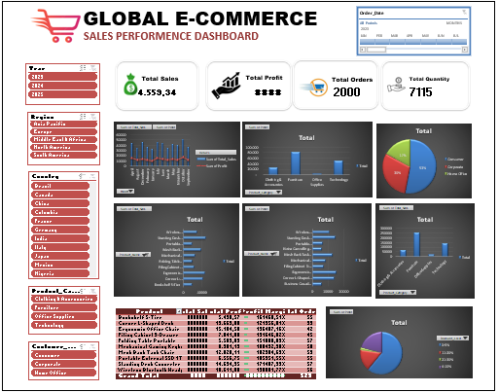
8. Excel Dashboard
PivotTables, PivotCharts, slicers, and KPI cards
INSERT SCREENSHOT
FINAL EXCEL DASHBOARD
Pivot Analysis
Sales, profit, product, customer, and regional performance analyzed using PivotTables and PivotCharts.
Slicers
Year • Region • Country • Product Category • Customer Segment • Order Date
Dashboard KPIs
Total Sales • Total Profit • Total Orders • Total Quantity Sold
Value
Enables interactive sales monitoring and identifies key performance patterns across products and markets.
11

Slide 11
9. Multi-Tool Workflow
How each tool contributes to the project
Python — Data Preparation & Analysis
Used for data understanding, cleaning, validation, and feature engineering. Performed exploratory data analysis (EDA), correlation analysis, and supporting visualizations to identify sales patterns and profitability relationships. The prepared dataset was exported for dashboard development.
Power BI — Interactive Data Visualization
Used to develop an interactive Global E-Commerce dashboard featuring key performance indicators, sales trends, product profitability, customer segmentation, and regional performance. Interactive slicers enable dynamic exploration of business metrics.
Microsoft Excel — Business Reporting & Dashboard
Used to perform PivotTable-based analysis and develop an interactive sales dashboard using PivotCharts, KPI cards, and slicers. Provides a familiar reporting environment for monitoring sales, profit, order volume, and product performance.
12

Slide 12
10. Business Recommendations
Actions suggested by the observed attrition patterns
Maintain Probability: With a total profit of 158.87K and a profit margin of 32.79%, the business should regularly monitor product-level margins to maintain overall profitability.
Increase Average Order Value: With an average order value of 242.28, the business can test product bundling, cross-selling, and personalized offers to increase revenue per transaction.
Strengthen customer retention: With 1,534 customers and 2,000 orders, the business should further examine repeat-purchase behavior and develop targeted customer retention strategies.
Optimize Product Performance: Use product-level sales and profit analysis to prioritize profitable products and investigate categories with lower margins.
Improve Regional Decision-Making: Use country- and region-level sales and profit comparisons to guide market-specific strategies and resource allocation.
13

Slide 13
11. Key Insights
Overall Sales Performance : The business generated total sales of 484.56K from 2,000 orders, with an average order value of 242.28.
Business Profitability: Total profit reached 158.87K, representing an overall profit margin of 32.79%. This indicates that approximately 32.79% of sales revenue was retained as profit.
Customer & Order Performance: A total of 1,534 customers contributed to 2,000 orders, with 7,115 units sold across transactions.
Product Performance Analysis: Product-level comparisons enable the identification of high-revenue products and evaluation of whether strong sales performance is accompanied by strong profitability.
Regional & Customer Segment Analysis: Regional and customer segment comparisons provide a basis for identifying differences in revenue contribution and profitability across markets and customer groups.
14

Slide 14
Global E-Commerce Sales Analysis
Python • Power BI • Excel
Thank You

